Slide 1
SOFTWARE
Software consists of step-by-step instructions that the computer follows to perform a task or solve a problem.
“Soft” in the sense that the instructions are not touchable the way hardware components are.
Note that software basically consists of programs (electronically coded instructions), and not data. Hence, software is “run”, and data is “processed”.

Slide 2
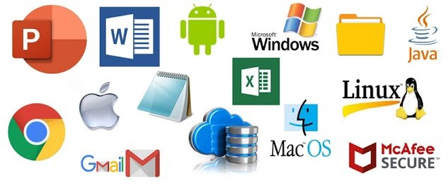
SOFTWARE
Principally, software can be classified into these categories:
  System software
  Applications software
System software is a suite of computer programs that control and manage the basic operations of the computer and also act as interface between the user and the computer.
System software is also the platform on which applications software are run.

Slide 3
SYSTEM SOFTWARE
Without the system software you won‘t be able to run any application software.
While you are using the computer or running application software, the system software is in the background making sure that the hardware carries out the tasks you want to perform.
Because system software is the closest to the hardware, it must handle a number of difficult and tedious tasks that include:

Slide 4
SYSTEM SOFTWARE
a) System Initialization: Initialization process that takes place on switching on the computer system.
At this point, the system software stores the hardware configurations, for example type of monitor and amount of internal memory available, and loads the operating system.

Slide 5
SYSTEM SOFTWARE
b) Managing System Resources: This task entails controlling of the execution of the application software and coordinating how the various peripherals work together.
c) Utilities: These are subprograms that manage the interface to storage devices like the hard disk and the CD-ROM.
They also handle such tasks as file storage and retrievals, file copying, and disk formatting.

Slide 6
SYSTEM SOFTWARE
d) Handling Input / Output: This entails responsibilities for input and output such as reading characters from the keyboard and displaying them on the screen.
As a computer user, you will have to use system software, it is therefore important to understand the role it plays in the computer system.

Slide 7
SYSTEM SOFTWARE
System software comprises of a large number of program units that can be grouped into the following categories:
  Operating system and BIOS (Basic Input / Output system)
  Device Drivers
  Utility programs
  Language Translators

Slide 8
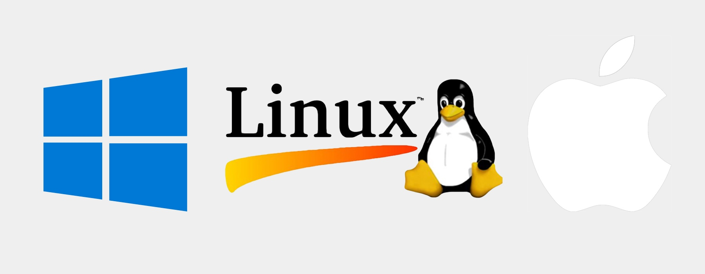
Operating System
The operating system, popularly referred to as OS is the most important of the system software components.
The operating system can be described as the
intelligence of the computer.
All the “common sense” that a computer exhibits is due to the operating system that runs it or runs on it.
It serves as the interface between the user and the machine and also enables communication between the computer and its connecting peripherals or ^{external devices.}Department of Computer Science, KNUST-
Kumasi

Slide 9
Major functions of the OS
It serves as the interface between the user and the machine and also enables communication between the computer and its connecting peripherals or external devices.
Manages the resources of the computer by
Allocating resources for use by users
Reclaiming resources after use
Deciding on who is allocated a resource to use at any given time if the resource is not sharable.
Responsible for loading application and other programs into memory when needed.

Slide 10
Operating System
The operating system gets loaded into the RAM – the main memory – upon “booting” the computer.
Booting refers to the process of switching on the computer from the main power supply and triggering off the execution of the bootstrap loader or boot routine – instructions wired into the ROM which in turn loads the operating system automatically into the RAM or main memory (usually from the hard disk).

Slide 11
Operating System
In the process other programs, diagnostic routines also starts up and test the main memory, the central processing unit, and other parts of the system to make sure they are all running properly.
Finally other programs known as device drivers are stored in the main memory that help the computer interpret, for example, keyboard characters or transmit characters to the display screen.

Slide 12
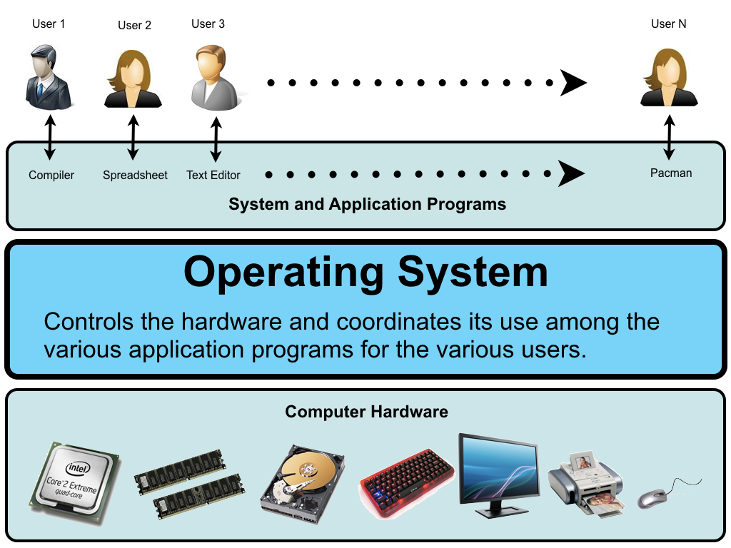
Operating System

Slide 13
Operating System
The operating systems from then on takes over the time to time running of the affairs of the system communicating with the user and performing complex tasks such as file, task, and job management.
File management involves storing and keeping track of file locations on disk, loading files form disk into the main memory and deleting files.
Task management involves the simultaneously running of more than one program and servicing the need of such programs.

Slide 14
Operating System
Job management entails managing units of work to be processed. Here job means a specified operation such as saving a document or organizing data into a document.

Slide 15
Operating System
Another important task of the operating system is the basic input /output system (BIOS).
This consists of program modules that manage the connecting peripherals or devices such as the keyboard, monitor, disk drives and parallel and serial ports.
BIOS also manages some internal settings of the computer such as date and time.

Slide 16
Operating System
Actually, this part of the operating system resides in the ROM and runs the diagnostic test upon booting the computer after which it then loads the rest of the operating system.

Slide 17
Common Operating Systems: Platforms
The operating system a computer is running is often referred to as its platform.
However, the operating system that can be run on a computer also depends on the type or brand of its processor.
Therefore, a computer platform is defined by its processor model and its operating system.

Slide 18
The type of processor used in a computer determines the type of machine language it uses, and the computer‘s operating system is created to work with that type of machine language thereby defining the computer‘s platform – the type of architecture of the computer or family – such as the IBM PC or Apple Macintosh.
Without some form of modification or conversion, software created for one type of platform will not work for or run on another platform.

Slide 19
Once you understand the platform, you can begin to understand what particular computer system is capable of and what type of tasks it can be used for.
As a computer user, in addition to learning how to use your application software, you must learn to some degree, the operating system with which they work.

Slide 20



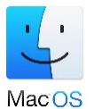

Common Operating Systems: Platforms
Today, more than half of microcomputers in the world run on Microsoft Windows.
However, popular operating systems available include the following:
DOS
Windows 3.X/95/NT/98/Me/2000/Xp/7/8
O/S2
Unix/Linux
Mac OS
NetWare

Slide 21
Device Drivers
Device drivers can be viewed as “divisional managers”.
When you buy an external device such as printer to connect to your computer, for the computer to be able to work with the device, there has to be some form of communication between the device and the computer.
To enable such communication, the device needs to “introduce itself” to the computer in some way specifying its nature and the “form of language it speaks”.

Slide 22
Such introduction is done by special software called the device driver.
Device drivers comprise software programs that support specific peripheral devices, such as printers, CD-ROM drives, mice, and display adapter cards.
The operating system commands the driver, which in turn commands the peripheral devices.
It contains directions for device-specific software drivers.

Slide 23
Latest versions of Windows come packaged with hundreds of device drivers from different manufacturers so that if you are running Windows you just connect most devices to your computer and off you go.
Devices that gets automatically recognized by the Computer are known as plug and play devices. The drivers for such devices are added as part of the operating system.

Slide 24
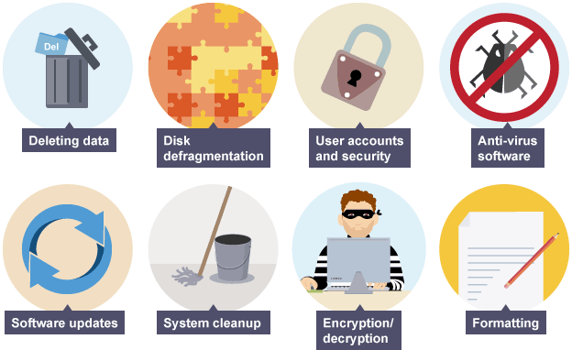
Utility Programs
Utility programs act like domestic aids.
In computer systems, utility programs are generally used to support, enhance, or expand existing programs built in for common purposes.
They perform tasks like: system diagnostics, backup, data recovery.

Slide 25
System diagnostics: In addition to the basic diagnostic routines that are performed by BIOS, more sophisticated diagnostics programs are provided in the form of a utility.
A diagnostic program compiles technical information about computer hardware, including peripherals that can be used to diagnose any technical problem.

Slide 26
Data Recovery: In computing there is always the danger of losing data due sudden technical problem.
Hence the need for a kind of “disaster management” mechanism.
Data recovery utilities provide such services and is used to restore data that has been physically damaged or corrupted.
This damaged could be as result of hardware failure like the crushing of hard disk, occurrence of power fluctuations during read/write operation or even by virus infection.

Slide 27
Virus Protection: We have come to be living in a dangerous world as a result of our own deeds and misdeeds, and just as human beings, computer programs and data are not left out in susceptibility to virus infections.
A virus – in the world of computers – consists of hidden, destructive programming instructions that are buried within a program or data file.
Often, they multiply by copying themselves to other programs, causing havoc.
Other times too, it can destroy programs and data and wipe out the hard disk clean.

Slide 28
Computer virus spread when people exchange storage devices such as pen drives or download (make copies of) files from computer networks or the internet just any how.
Antivirus utility program scans hard disks, pen drives, and memory to detect, give information of possible virus behavior, and destroy viruses.
Backup: For fear of ever persisting menace of data loss due unforeseen circumstances such as those mentioned in previous sections, it important to always backup – make duplicate copies of – important programs and files, so that in the event of any loss of data you can fall on the duplicate copies to recover the files.

Slide 29
Backup: For fear of ever persisting menace of data loss due unforeseen circumstances such as those mentioned in previous sections, it important to always backup – make duplicate copies of – important programs and files, so that in the event of any loss of data you can fall on the duplicate copies to recover the files.
Defragmentation: After several save and delete operations, there remain many scattered areas of stored data that are too small to be used productively.
- This is referred to as fragmentation.

Slide 30
High degree of fragmentation causes the computer to run slower than if all data in a file were stored together in one location.
Utility programs known as defraggers provide the service of defragmenting the disk, thus rearranging the data so that the data units of each file are repositioned together contiguously in one position on the disk.

Slide 31
Language Translators
Language translators are generally used by Computer Programmers.
These programmers normally write Computer Programs using languages such as COBOL, FORTRAN, C++, Visual Basic, etc in which instructions are written close to mathematical and English-like expressions.
E.g. NetPay = GrossPay - Deductions
These instructions tend to be meaningful to the programmer and not the computer as the computer understands only the machine language.

Slide 32
Since the program is not in the language that the Computer has been designed to understand, there is the need to have a program translator.
A program translator may be defined as any computer package capable of translating a source program written in either a high level language or an assembly language into a machine language.
There are three types of program translators namely Compilers, Interpreters and Assemblers.

Slide 33
INTERPRETER
Every program instruction is translated or interpreted on each occasion the program is run (not just once initially as with assemblers and compilers).
If any statement does not conform to or violates the rules or grammar (syntax) of the language an error message is displayed on the screen.
Until this error is corrected, program execution cannot proceed and this has the disadvantage of slowing down the running of the program.
An interpreter, however, allows errors to be corrected more quickly than a compiler which prints a (long) list of errors which have to be corrected as a whole rather than individually before program execution can
continue.
Department of Computer Science, KNUST-
Kumasi

Slide 34
ASSEMBLER
This type of software translates and assembles a program written in assembly code into machine (object) code.
The assembler translates the symbolic function codes into the equivalent machine operation code.
E.g. DIV SUM, NUMB
After assembling, the object program is retained on a storage device in machine code.

Slide 35
Errors are diagnosed during the assembly process. This is a once only process and does not have to be performed each time a program is run as with an interpreter.
Assembly programs tend to run faster than interpreted ones, because assembly language is low level and nearer to machine code and fewer instructions are necessary to accomplish a desired result.

Slide 36
COMPILER
A compiler has more capabilities than an assembler because each source program instruction generates a number of machine code instructions.
A compiled program may not be so efficient in the time taken to process a task because of the nature of the high level language used, COBOL for instance.
This results in more detailed and less direct instructions than those generated by an assembled program written in assembly code.

Slide 37
APPLICATION SOFTWARE
Application software is special computer programs that are specifically designed and written to perform specific tasks.
These software can be acquired directly from the software manufacturers or companies or even vendors that specialized in the sale and support of microcomputer hardware and software.
There are thousands of programs to choose from – games alone numbered over 2500 – and some of them can make life easier and more productive than you can imagine.

Slide 38
Application software are those designed to be used by a user for a specific purpose. For example, if a user wishes to type a document, then he/she would need a Word Processor which is an application software that allows a computer user to use his/her Computer in the same manner as he/she would have done using a typewriter.

Slide 39
Common Features of Application Software
Since the advent of Windows operating systems, all window based application software developed exhibit many similarities and functionalities that are characterized by the underlying operating system‘s graphical user interface.
Some common features of application software are
  Windows
  Scroll bar
  On-line Help Menu/Screen

Slide 40
Menus / Menu bar
Dialog box
Icons
Macros
Tool Buttons
OLE
Toolbars
Clipboard
Cursors
tutorial / documentation

Slide 41
Windows:
A window is a rectangular screen display of a running program or opened document or file with a title bar on top.
Several windows may overlay each other or cascaded alongside one another depending on the number of executing task.
Each window may show a different application display, such as a word processing document and a spreadsheet document.

Slide 42
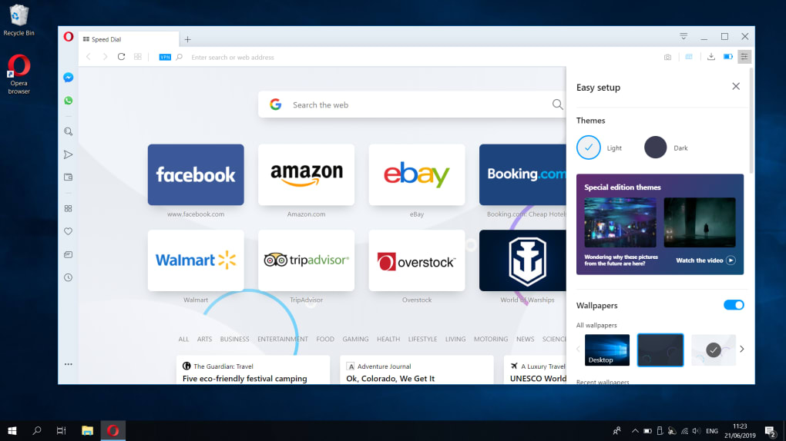
Window of a Program

Slide 43
Menu/Menu bar:
A menu bar is a row of menu options displayed across the top or the bottom of the screen.
A menu is a list of command options or choices. Various tasks that can be performed in an application are grouped under different names or titles.
To perform some particular task, click the mouse button on the menu option to open the menu containing the task and then select that particular task.

Slide 44
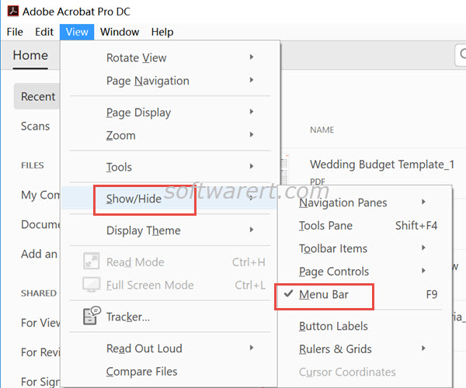
Menu

Slide 45
Icons:
An icon is a small on-screen pictorial object that represents a program or a file.
Icons serve as short-cut way to access the target programs or files and are therefore referred to as short-cuts.
Tool buttons:
These simulated buttons are provided to serve as quick way of executing commands.

Slide 46
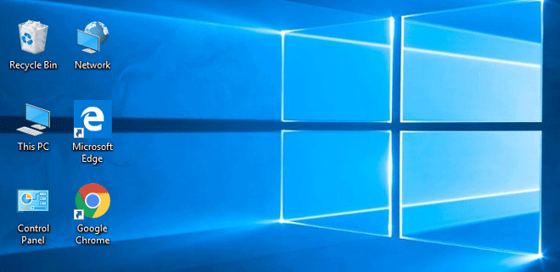
ICON

Slide 47
They are often small graphic objects arranged on toolbars.
Tool buttons when clicked with the mouse triggers off execution of the commands associated with them.
Tool bars:
A toolbar is an arrear of on-screen tool buttons, displayed below the menu bar, and used to activate a variety of functions of the applications program.
They can be customized and move around the screen.

Slide 48
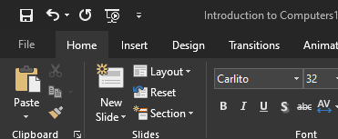
Toolbars and Tool Buttons

Slide 49
Cursors:
The cursor, sometimes referred to as the insertion point, is the blinking movable vertical or horizontal line symbol on the screen that indicates where the next data is entered.
You can move the cursor around using either the mouse or the directional arrows on the keyboard.

Slide 50
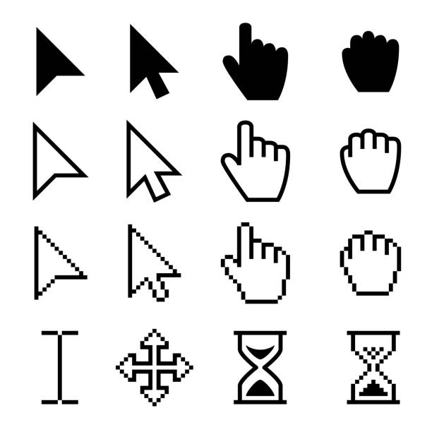
Cursors

Slide 51
Scrollbars:
Scrolling is the way to quickly move through text in a document or the active file upward or downward.
Using the directional arrow keys or a mouse, you can scroll through the display screen and into the text above and below.
However, when you have to scroll through a large file that spans many pages, it is easier to using the scrollbars.

Slide 52
There are vertical scrollbars as well as horizontal scrollbars.
Vertical scrollbars often appear at the right side of the document screen small triangular arrows pointing up and down.
To scroll up (or view the bottom part of document), simply click the left mouse button on the down-pointing small triangular arrow of the scrollbar.
To view the top part of document scroll down by clicking the up-pointing small triangular arrow of the scrollbar.

Slide 53
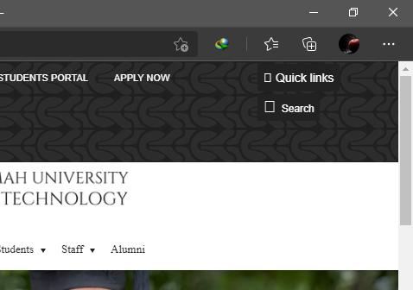
Scroll Bar

Slide 54
Horizontal scrollbars often appear below a document window and are used to scroll the document window right or left.
Dialog box:
A dialog box is a window through which the user provides some needed information that the computer or the application program require to perform some task.
It also used to display helpful messages at times.

Slide 55
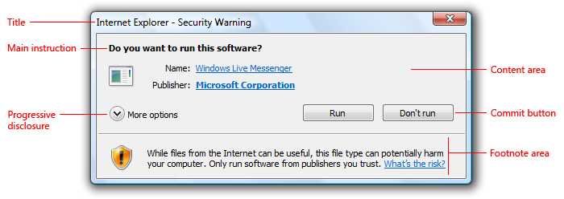
Dialog Box

Slide 56
Macros: Series of steps that may be needed to perform a task can be grouped together in a way and the entire routine assigned a keystroke.
Pressing the Ctrl key on the keyboard in combination with the assigned key triggers the execution of the programmed routine assigned to the keystroke.
These programmed steps are referred to as macros.

Slide 57
OLE (Object Link and Embedding):
This feature enables the user to link and/or embed document of one application program such as a spreadsheet to or in another such a word processor.
Changes made to the embedded object affect only the document that contains it.
If the object was rather linked, then changes made to the object are automatically made in all the linked documents that contain it.
Thus OLE facilitates sharing and manipulating of information.

Slide 58
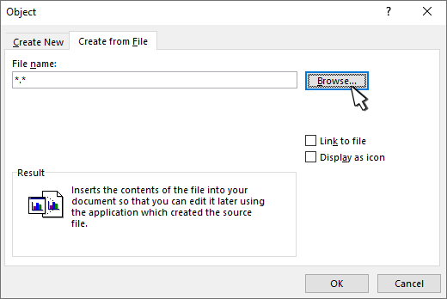
Link to a file in word

Slide 59
An object may be a document, worksheet, picture or even a sound recording.
Clipboard:
During working sessions, it sometimes become necessary to copy an item or part of a document from one document and then paste it into another document or application or even in another part of the same document to save time and labor.
The area in the memory where the copied item is held temporarily before and even after it is pasted to a destination is known as the clipboard.

Slide 60
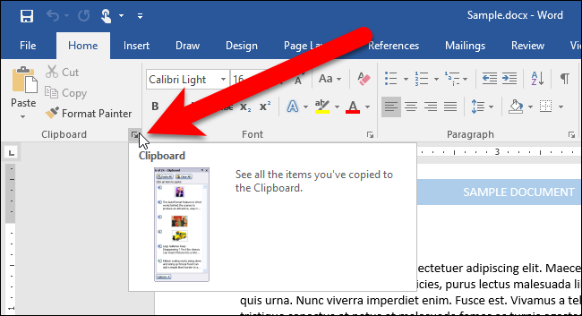
Clipboard

Slide 61
Tutorial and Documentation:
This resembles the on-line Help but rather acts like an electronic instruction book or program that takes you through a prescribed series of steps to help you learn the product.
Tutorials are supplemented with documentation.
Documentation is a user manual or reference manual that is a narrative and graphical description of a program.
It may be instructional but often features and functions are grouped by category for reference purposes.

Slide 62
Documentation may come in booklet form or on diskette or CD-ROM; it is sometimes also available on-line from the manufacturer.
On-line Help Menu and Screen:
A Help menu offers a choice of help screens – specific display of explanations of how to perform various tasks, such as setting the page lay-out of a document, embedding picture objects and many more.
On-line help screens mostly can be displayed by opening the Help menu on the menu bar or clicking on the F1 function key on the keyboard.

Slide 63
Help screens serve like electronic reference manual. Sometimes, on-line help may also come in the form of
a wizard – in-built program that leads the user through a series of questions to determine exactly what the user‘s problem really is.

Slide 64
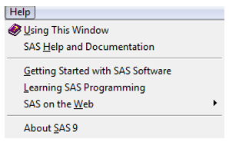
Help Menu

Slide 65
Word Processing Software:
The traditional machine for typing out documents was the typewriter.
However, the machine has long out-lived its usefulness.
Word processing programs also come with several features for “dressing up” documents with variable margins, font types and sizes, and styles.

Slide 66
All these can be done by the user on screen in “wysiwyg”– what you see is what you get – fashion, meaning the screen displays documents exactly as it will look when printed.
Word processing offers additional features such as spelling checkers and thesaurus.
Among popular word processors are Microsoft Word, Lotus Word Pro, and WordPerfect.

Slide 67
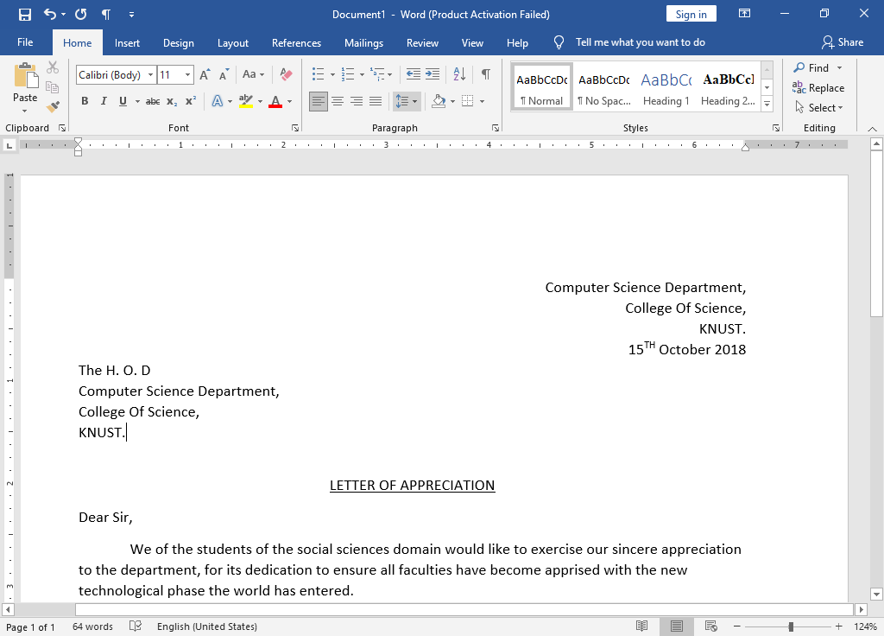

Slide 68
Spreadsheet Software:
Traditionally, a spreadsheet was a grid of rows and columns, printed on special green paper, which was used by accountants and others to produce financial projections and reports.
Accounting personnel using the spreadsheet often spend long hours and days penciling tiny numbers into countless tiny rectangles.
When one figure changed, all the computations on the sheet had to be done all over again.

Slide 69
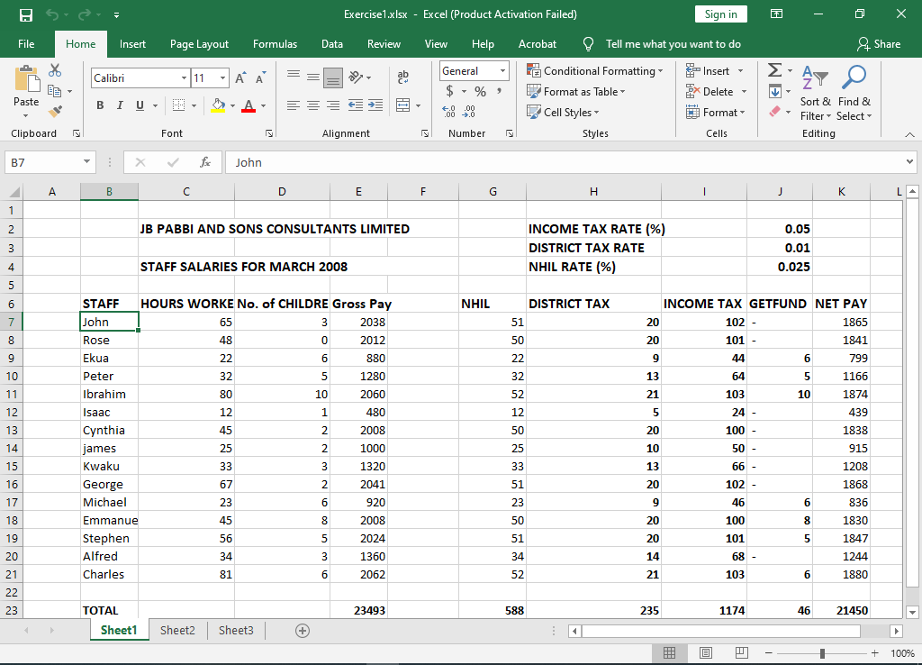

Slide 70
An electronic spreadsheet allows users to create tables and financial schedules by entering data into rows and columns arranged as a grid on a display screen.
The electronic spreadsheet is computerized and largely incorporates automation of computations.
This software tool quickly became the most popular small-business program, and has been held directly responsible for making the microcomputer a widely used business tool.
Today, the principal spreadsheet programs include Microsoft Excel, Lotus 1-2-3, and Quatro Pro.

Slide 71
Presentation Software:
Presentation software are software tools designed to use graphics and data/information from other applications or software tools to communicate or make a presentation to audience such as clients, supervisors, directors, or even students in a lecture theatre.
Presentations software may make use of some analytical graphics such as charts but they usually look much more sophisticated, using, for instance, different texturing patterns, color, and three-dimensionality.

Slide 72
Presentation graphics are output as 35mm slides, which can be projected on a screen or displayed on a large monitor.
Presentation software packages often come with slide sorters, which group together a dozen or more slides in miniature.
The person making the presentation can use the mouse to click a slide to bring it up for viewing.
Some also include clip art (grouped art works) that can be electronically cut and pasted into the graphics.

Slide 73
Depending on the system‘s capability, you can add text, animated sequences, and sound.
Examples of well-known presentation software packages are Microsoft PowerPoint, Aldus Persuasion, Lotus Freelance Graphics, and SPC Harvard Graphics.

Slide 74
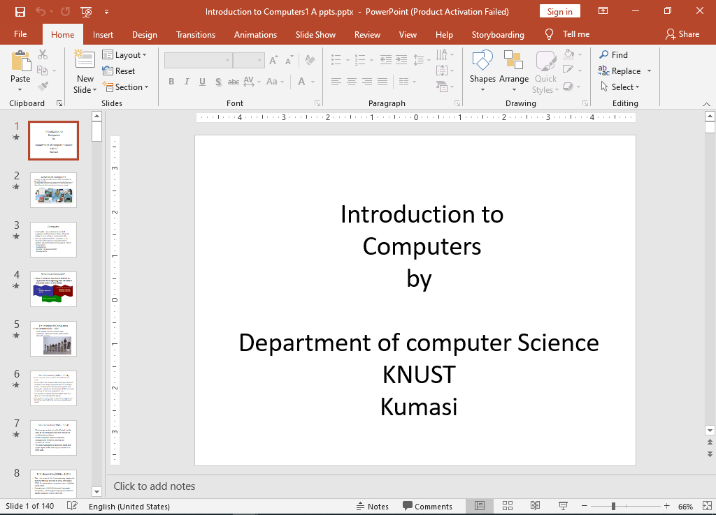

Slide 75
Database Management System Software:
Generally speaking, a database is any electronically stored collection of data in a computer system.
To be more specific however, a database can be described as a collection of interrelated files in a computer system.
These computer-based files are organized according to their common elements or fields, easy retrieval.

Slide 76
Database Management System (DBMS) software, therefore, is a program that controls the structure of a database and access to the data.

Slide 77
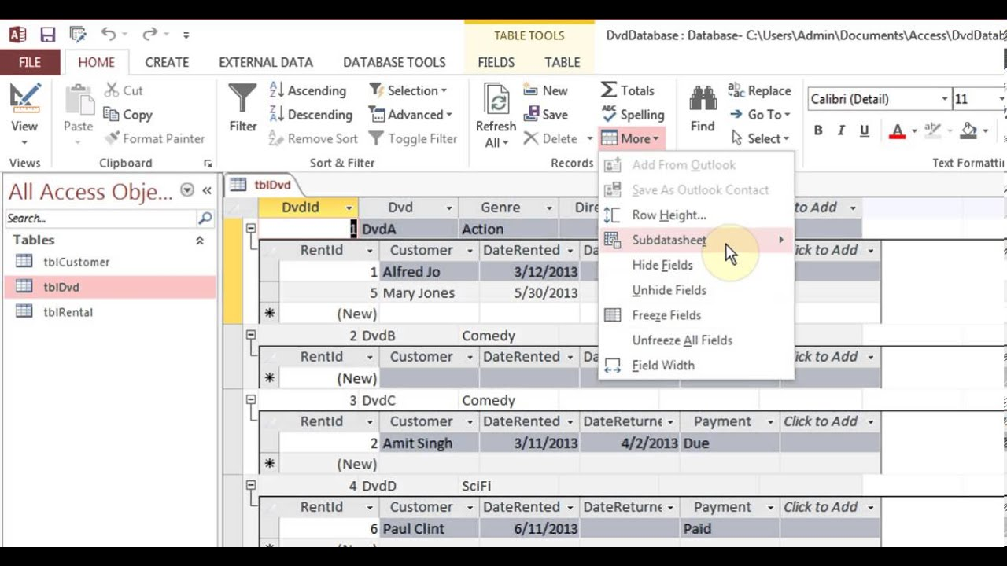

Slide 78
A DBMS has several advantages over the traditional file managers or flat-file management system.
A DBMS can access several files at one time as against file manager that can access only one file a time.
Also, you can not extract information across more than one file with the flat-file system while this can be easily accomplished with a DBMS.
For example, using a file manager or the flat-file system, you could call up a list of all Faculty of Science students.

Slide 79
You could also call the list of all Africa Hall students. But you could not extract all Faculty of Science students resident in Africa Hall. A DBMS allows you to do that and even more.

Slide 80
Databases are getting more and more sophisticated. Some years back, they included only text.
Today, they incorporate new data types – not only texts but also pictures and even sound, and animation.
Some popular database management software include Microsoft Access, Microsoft Visual FoxPro, Paradox, and Claris Filemaker Pro.

Slide 81
Statistical Packages:
These packages are used by Computer users for statistical analysis and also for producing different types of graphs.
They can be used for performing regression analysis, computation of statistical parameters such as the mean, median, standard deviation, kurtosis, skewness, etc.
They can also be used for solving systems of linear equations, etc. Typical examples of statistical packages are SPSS PC+, MathLab, MINITAB, MATHEMATICA, SAS, etc.

Slide 82
Accounting Packages:
These are packages designed to be used by Companies and individuals for accounting purposes.
Thus, these packages can be used in preparing documents such as Trial Balance, Balance sheet, Statement of account, Invoices, etc.
They can be used by individuals at home in tracking their daily transactions or income and expenditure.
Examples of these packages are SAGE Accounting, CA-Simply Accounting, MS Money, Quicken, etc.

Slide 83
Communication Packages:
These are software packages that allow two or more Computer users to communicate with one another if the necessary hardware components are in place.
Examples of these packages are Derlina WinFax, EUDORA, INTERNET in a Box, etc.
Web Browsers:
These are packages that enable one to surf or browse the internet for data, information, chatting, sending and receiving emails, etc.

Slide 84
Some of the commonly used web browsers are Yahoo, Netscape, Explorer, Mozilla Firefox, Google, etc.

Slide 85
COMPUTER NETWORKS
A network is basically a combination of hardware and software that send data from one computer to another.
It can also be defined as two or more computers that are connected to each other to share and exchange data.
The hardware consist of the physical components that carries data or signals from one point to the other while the software are the instructions that make the services expected from a network possible.

Slide 86
COMPUTER NETWORKS
A computer network must meet a number of criteria, notable among these are performance, security and reliability.
Performance is normally measured in terms of transit time and response time.
The performance of a network can be affected by the number of people on the network at a time, the transmission medium, etc.

Slide 87
COMPUTER NETWORKS
Security basically deals with preventing unauthorized users to access, update or damage data.
It also deals with the policies needed for implementation and procedures needed for recovery from breaches and data loses.
Reliability is usually measured by the frequency at which failure occurs, the time it takes the network to recover from a failure and the
network‘s robustness in an emergency or disaster.

Slide 88
TYPES OF COMPUTER NETWORKS
As mentioned earlier, a network consists of two or more devices that have been connected through links to send and receive data.
A link is simply a communication pathway for transferring data from one device to another.
There are basically two types of connections namely point-to-point and multipoint connections.
For a point-to-point connection, there is a dedicated link between two devices and the entire capacity of the link is set aside for transmission between these two devices.
A multipoint connection on the other hand is one in which more than two devices share a common link.

Slide 89
COMPUTER NETWORKS
A multipoint connection on the other hand is one in which more than two devices share a common link.

Slide 90
NETWORK TOPOLOGY
A network topology refers to the way in which the network devices are connected to each other.
When two or more devices are connected they form a link, and one or more links form a topology.
In a network the devices are normally referred to as nodes.
There are basically four main types of networking and these are the mesh, star, bus and ring.

Slide 91
MESH TOPOLOGY
In a mesh topology each device has a dedicated point-to-point link to all other devices in the network.
In other words, there is a direct connection between every two devices on the network.
A typical mesh topology is as shown below:

Slide 92
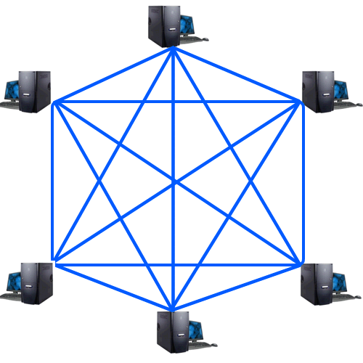
MESH TOPOLOGY

Slide 93
STAR TOPOLOGY
In a star topology, each device has a dedicated point-to-point link only to a hub; a central controller.
In other words, there is no direct link between any two devices.
A typical star topology is as shown below:

Slide 94
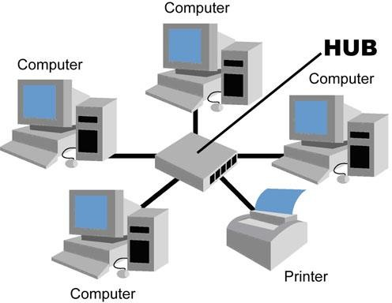
STAR TOPOLOGY

Slide 95
BUS TOPOLOGY
In a bus topology one long cable called the bus cable is used to link all the devices in a link.
The bus topology is a multipoint.
Each device is connected to the bus cable by drop lines and connectors (taps)

Slide 96
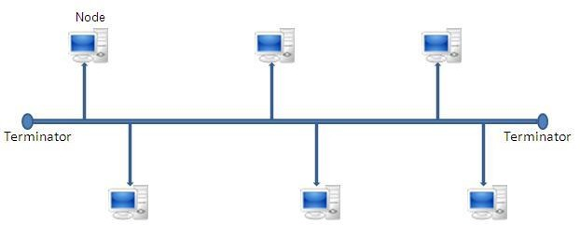
BUS TOPOLOGY

Slide 97
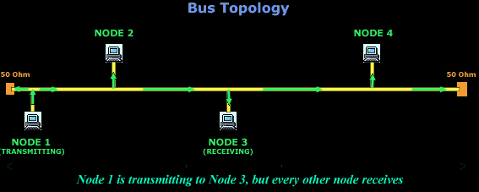

Slide 98
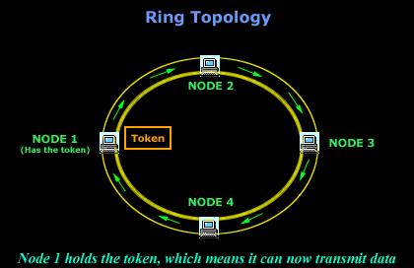

Slide 99
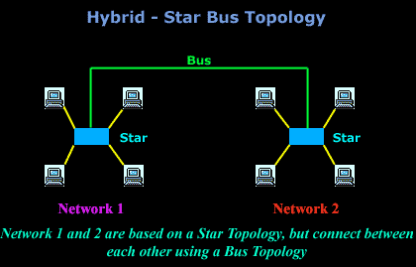

Slide 100
THE WINDOWS OPERATING SYSTEM
Whenever a new computer is purchased, an operating system has to be installed on the Computer before the Computer can be used.
One of the most popular operating system is the Windows.
The operating system is a software package that enables you to communicate with your computer by way of running application programs.
There are different versions of the Windows such as Windows 98, Windows 2000, Windows XP, Windows Vista, Windows 7, etc.

Slide 101
Windows as an Operating System
Unlike Disk Operating System (DOS) that allows you to run a single application at a time, the Windows operating system has multitasking capabilities, meaning that it can run several application programs at the same time.
For the purpose of this course we will consider Windows 7 as it is more popular than the other versions. Every operating system must be able to perform the following functions:

Slide 102
Windows as an Operating System
Manage the Computer resources such as the memory, the processor, date files and the other hardware devices.
Allocate resources for use.
Must have a policy such as round robin, first-in- first-out, etc in deciding who to allocate a resource to when multiple requests for a particular resource are made at the same time.
Reclaim resources after use.

Slide 103
The Windows 7 Desktop
All the different versions of Windows use a desktop for the standard interface.
Think of the desktop as workspaces where you can access everything that is on your computer.
For example, using your desktop it is possible to access your disk drive, run an application program, access the internet, change your computer settings, etc.
The desktop contains three main items namely the start button, the taskbar and icons.

Slide 104
The Windows 7 Desktop
Start button: This is the most important tool you will frequently use while working in Windows 7.
Whenever the start button is clicked, it gives you the option of running a program, logging off so that another user can use the Computer and turning your computer off when you no longer wants to use it.
Taskbar: This bar enables a computer user to switch between open programs and windows.

Slide 105
The Windows 7 Desktop
Remember we have already said that Windows is multitasking and therefore one can have a number of programs opened at the same time and is the taskbar that makes it possible for you to switch between the programs.
Icons (or graphical pictures): These are normally small graphical images or pictures that represent applications, files, and other parts of the operating system.

Slide 106
The Windows 7 Desktop
For example, one of such icons is the Recycle Bin where all files that are deleted are temporary stored, another is my Computer which makes it possible to access information on the different drives of your computer.

Slide 107
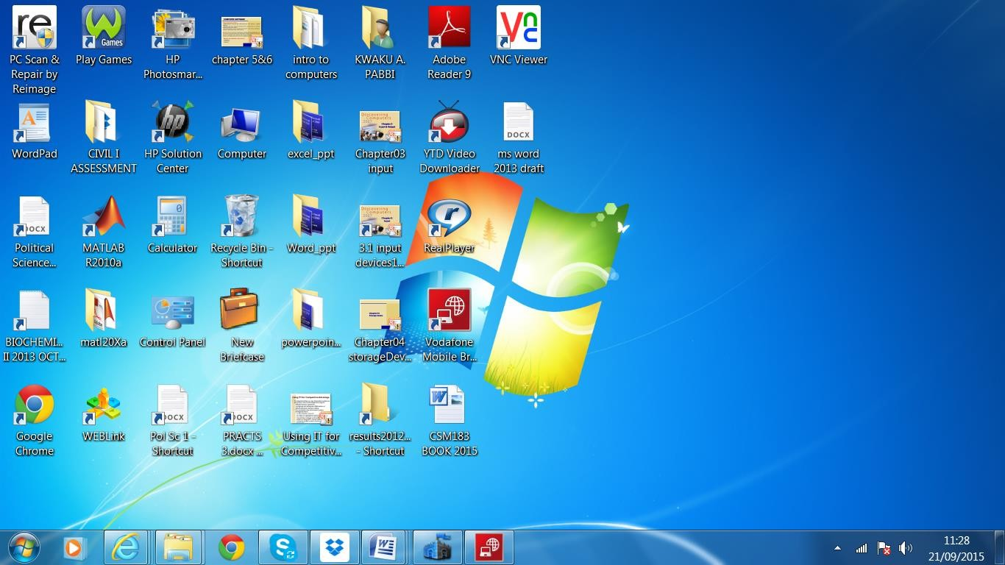
The Windows 7 Desktop

Slide 108

The Start Menu
The start menu is basically used to explore Windows.
Also, any application program that does not have a shortcut on the desktop can only be run by first clicking at the start and then selecting the appropriate options.
The start menu appears when the start button
The Start
is clicked.
button

Slide 109
The Start Menu
When the start menu opens, you will see on the left side the list of programs on your computer and the right side gives you access to the common Windows folders such as My Documents, Control Panel, Help and Support, Search, and Run.
The All Programs when highlighted gives you a pop-up menu of all application programs and utility programs that have been installed on your computer.

Slide 110
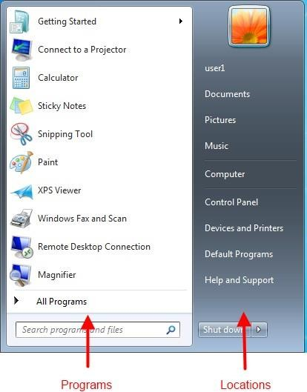
The Start Menu
One good thing about the start menu is that it is able to keep track of items you've recently opened and places the icon on the Start menu so that you can easily open it the next time you open the Start menu.

Slide 111
The Icons
These are the small pictures on the desktop.
Some of the icons are for objects.
Object icons allow you to open programs and files. Examples of object icons include My Computer, Recycle Bin, and Internet Explorer.
Non object icons are normally shortcut icons and these allow you to run application programs or open files quickly.
The shortcut icons are those with little arrow in the left corner.
Adding or deleting an icon does not affect the programs on your computer but just the link.

Slide 112
Opening a program using an icon
There are many ways that one can run a program. If the program has an icon, then its best to open the program using its icon.
To do that,
Place your mouse over the icon of the program you intend to open.
Then, double-click the icon.

Slide 113

The Taskbar
The taskbar is the small blue bar that appears you see at the bottom of your desktop.
It contains the Start menu and the Quick Launch bar, which contains icons for Internet Explorer, Windows Media Player, and Windows Explorer
Show Desktop appears to the far right hand corner
Click an icon to open a program.
Click Show Desktop to quickly view your desktop without closing any programs or windows.
The Start button and Quick Lunch
_{toolbar on task}D_{b}ep_{a}ar_{r}tment of Computer Science, KNUST-
Kumasi

Slide 114
The Taskbar
The box on the right is called the Notification Area. This area shows the
clock and several other icons depending on what one has installed on his/her computer.
Notification Area on Taskbar
For example, if you have installed yahoo messenger and an anti virus software on your computer then icons for these will also appear in the Notification Area detailing the_{De}s_{p}t_{ar}a_{tm}t_{en}u_{t o}s_{f Co}o_{mp}f_{ute}t_{r}h_{Scie}e_{nc}s_{e,}e_{KNU}s_{S}o_{T-} ftware.
Kumasi

Slide 115
The Taskbar
Also, when you are printing a document, the printer icon appears and disappears when the printer finishes with the printing.
Microsoft and other software developers also use the Notification Area to remind you when software updates are available for download.
Whenever you open or minimize a window or program, a rectangular button appears on the taskbar that shows the name of the application.
However, these buttons disappear when you close a window.

Slide 116
Log On/Off and Switch Users
Any Computer that is running Windows 7 can be used by more than one person at a time.
For example you may have one Computer in your room shared by you and your mates.
In order to keep record of each others information on the shared Computer such as your unique settings, email account and documents, Windows 7 allows everyone who uses your computer to have separate computer accounts.
To use your account, you will have to log on and you will have to log off after you have finished using your computer.

Slide 117
Log On/Off and Switch Users
Windows 7 even enables you to log off the computer so someone else can log on without having to restart the computer.
Switching user means changing users.
Note that for a particular PC only one user can use the Computer at a time.
However, if two or more people have already log on to the same Computer, only one of them can be active at a time, therefore, anytime someone else intends to use the Computer he/she must switch to his/her account on the Computer.

Slide 118
Log On/Off and Switch Users
To shut down, restart or switch users,
  Click the Windows button.
  Click “Shut down” one time to immediately shut down your computer.
  Or Click the arrow for more options.

Slide 119
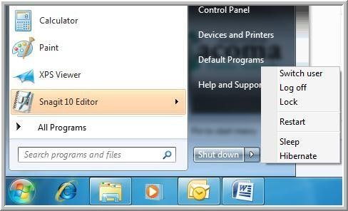
Log On/Off ,Switch Users or Restart
To log off/switch users or restart

Slide 120
Log On/Off and Switch Users
Switch User allows someone else to log on to the computer. If you choose to Switch User, your applications will continue to run in the background while the new user logs on.
If you choose Log Off, your applications will close and you will have to log on and run your applications again if you have to do so.
In any case, you are taken to a Windows 7 Log-on screen where you are prompted to enter your username and password. Note that if the username and/or the password provided is incorrect Windows 7 will deny you access to the Computer. You must therefore remember your password at all times.

Slide 121
Turning Off and Restarting the Computer
Any time you finished using a Computer, you must turn it off.
The following is the correct procedure for turning off a Computer.
Failure to do so may at times result in loss of data or file.
For example, whenever you turn your computer off by switching the power off you are likely to damage your Windows 7 settings and the next time you turn your Computer on Windows 7 will display a message that you did not turn off your computer the proper way and will you like to start your computer in a ‘safe’ mode?

Slide 122
Turning Off and Restarting the Computer
To restart the computer: Most of the time, after you have installed a new driver or program, you are prompted to re-start your computer.
This is to enable the Computer to recognize the new device whose drivers have just been installed.
The procedure for re-starting a computer is as follows:
  Click the Start menu.
  Click the arrow to the right of the shut down button
  Click the Restart option

Slide 123
Running Programs
Running a Computer (application) Programs enable you to do work on the computer.
On your Computer every application program has been installed for a particular work.
For example, if you intend to type a document then you will have to install a word processor such as Microsoft Word on your Computer.
You can easily run a program from the Start menu using the All Programs button.

Slide 124
Running Programs
To run a program using the Start menu:
Click Start.
Click All Programs and move the mouse pointer over the program you intend to run (it turns blue).
Click to run the program you have highlighted. (Note that programs with small black arrows beside them will open another cascading menu. Just drag your mouse pointer to make your selection.)
To close a program, click the located at the top right of the window.

Slide 125
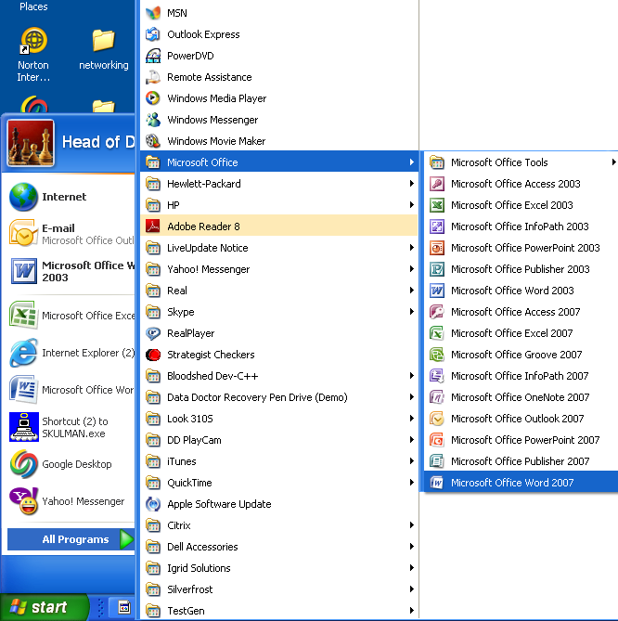
Launching Microsoft Word from the Start menu
Figure7.7 The windows 7 Start menu with All Programs option selected

Slide 126
Launching Microsoft Word from the Start menu
To run the Microsoft Word 2007 these are the steps needed:
Click Start
Select/Highlight All program (it turns blue)
Move mouse pointer over to Microsoft Office (it turns blue)
Move mouse pointer over Microsoft Office Word 2007 (it turns blue)
Click the highlighted Microsoft Office Word 2007, and the application will run.

Slide 127
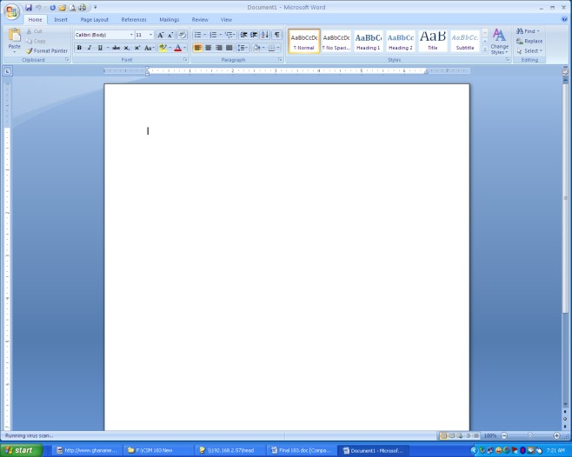
Windows 7 Bars and Buttons
Windows got its name from one of its most basic elements: the window.
The rectangular work area for a program, file, or other task is called a window.
Microsoft Word Initial Screen showing a blank
Workspace

Slide 128
Windows 7 Bars and Buttons
On going through the steps above to run Microsoft Office Word 2007 for example, you will obtain the screen (window) to the left.
The three buttons at the top left of the window (title bar) are the Windows 7 buttons.
The white area inside the window is the workspace where you do your work with the program, such as typing a letter.
Note that the workspace appears different for different programs.

Slide 129
Windows 7 Bars and Buttons
There are several other several Windows tools, menus, and commands that make the operating system easy-to-use.
The title bar is the horizontal blue bar at the top of a window. By default, it displays white text on blue background.
The Title Bar at the top of a Window

Slide 130
Windows 7 Bars and Buttons
The Control menu button is the icon at the far left end of the title bar. The Control menu button opens a menu you can use to control the window.
The Close button is at the far right end of the title bar. It is usually a red box with an X in it. It is used to close a window whenever one does not intend to use the window again by just clicking the Close button.
The first two left buttons shown here are the
Minimize and Maximize buttons respectively.

Slide 131


Minimizing, Maximizing, and Restoring Windows
With Windows XP, you can easily enlarge, hide, or shrink a window using the Minimize, Maximize, and Restore buttons.
The Minimize button is the leftmost of the three buttons at the right end of the title bar.
This button has a small dash (or minus sign).
Figure7.10 Minimize, Maximize, and Restore buttons

Slide 132
Minimizing, Maximizing, and Restoring Windows
The Minimize button shrinks the window and places it on the taskbar while leaving the program running at the background.
The Maximize button which is to the immediate right of the minimize button, looks like a small window, It is used to enlarge a window to cover the entire desktop (screen).
After a window is maximized, the Maximize button changes to the Restore button which looks like two windows near one another.

Slide 133
Minimizing, Maximizing, and Restoring Windows
If you click the Restore button, the maximized window shrinks to its previous size (the size it was before you maximized it).
Note that when a window is maximized, you can double click the title bar to restore the window to its previous size and if you double click again the window will be maximized.

Slide 134

Sizing Windows
Sometimes you might want to see to opened windows on your screen at the same time.
If you use maximize or restore you can only see one screen at a time.
However, you can manually resize the open windows so that you can see all of them at the same time.
Sizing window is slightly different from minimizing, restoring, or maximizing.
Note: You cannot size a window if it has been maximized.

Slide 135
Sizing Windows
To resize a window,
Move the mouse pointer over any corner or border of the window.
The mouse pointer changes into a double-headed arrow pointing either up and down, left and right, or diagonal if the mouse pointer is move over the bottom or top, left or right, or a corner respectively.
You should always make sure that the mouse pointer changes to a double-headed arrow before you proceed to the next step.

Slide 136
Sizing Windows
Click and hold down the left mouse button.
Drag the double-headed arrow out or in to make the window larger or smaller.
Release the mouse button when the window is the size you want.
Alternatively, you can also resize a window by the following method:
Right click any blank area of the title bar.
Select move from the menu options.

Slide 137
Sizing Windows
Press either the Up or Down arrow key of your keyboard if you want the window to be longer or shorter.
You are to press the left or the right arrow key if you want the window to be wider or narrower.
This locks the one side of the window to the mouse pointer such that as the mouse pointer is moved around the window resize.
Click the left button of the mouse when the desired size is obtained.

Slide 138
Sizing Windows
Before clicking at the left mouse button, you can press the escape (Esc) key if you change your mind on resizing so as to return your window to its initial size.

Slide 139
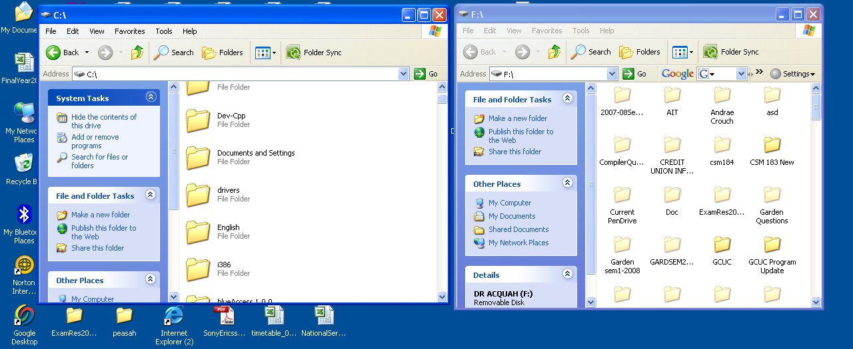
Moving a Window
Two Windows placed side by side on the
Desktop

Slide 140
Moving a Window
Sometimes one window may obscure another window or an item you want to click on or view.
For example, if you open two windows (of two disk drives) and you want to copy a file from one window to the other, it will be easy if the two windows can be seen at the same time (as shown above).
Therefore, if one of the windows is overlapping on the other window then one or more of the windows must be moved so that all windows can be see at the same time.

Slide 141
Moving a Window
To move a window,
Place the mouse pointer over the title bar (at the top of the window).
Click and hold down the left mouse button. (Note that you cannot move a window that has been maximized)
Drag the window to the place where you want it and release the mouse button.
Alternatively, you can also move a window by the following method:
Right click at any blank area of the title bar

Slide 142
Moving a Window
Select move from the menu options
Press any of the cursor control movement (arrow) keys of your keyboard to lock the window to the mouse pointer.
Simply move the mouse pointer where you want the window to be. Note that as you move the mouse pointer anywhere on the desktop the window to be moved moves accordingly.
Click the left button of the mouse when the desired position is obtained.

Slide 143
Moving a Window
Before clicking at the left mouse button, you can press the escape (Esc) key if you change your mind on moving the window so as to return your window to its initial position.

Slide 144
Switching Between Windows
Windows 7 allows you to have more than one program or window opened at the same time so that you can easily move between open windows if the need be.
The window you select becomes the active window. To know that a window is active on the desktop, its title bar is deep blue.
When a window is inactive, the title bar is light blue.

Slide 145
Switching Between Windows
To switch between windows you will have to
Open all the required windows.
Size the windows, if necessary, so they are open on the desktop.
Click on any part of the window you want to work with and this will make the window the active one.
To make a different window the active one simple repeat the third step above.
OR
Simple click the required program/window button on the taskbar to activate the window you want to
work with.
Department of Computer Science, KNUST-
Kumasi

Slide 146
Switching Between Windows
Unlike previous versions of Windows, Windows7 keeps the taskbar from getting too cluttered.
It groups the buttons when you open too many windows such that all the names cannot appear on the task bar. For example, when you open word, you will see one button on the taskbar.

Slide 147
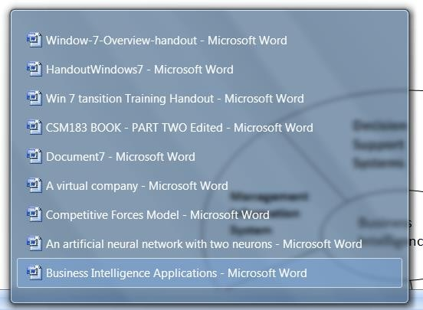
Grouped Buttons on Taskbar

Slide 148
Switching Between Windows
However, if you have three or more email message windows open, one button represents the Outlook Express's open windows as shown in the figure on the left.
You can open any of the windows by first clicking at the Outlook Express button on the task bar.
This pops up a list of open windows within Outlook Express.
Simply move the mouse pointer over the required window and click the left button of the mouse.

Slide 149
Switching Using the Keyboard Method
When you have more than one window open, you can also switch between them using the keyboard.
Using the mouse is faster however if you do not have a mouse then you may have to use your keyboard.
To do so using the keyboard,
Open the required programs or windows.
Press and hold down the Alt key while pressing the Tab key.

Slide 150
Switching Using the Keyboard Method
A menu containing all files and program icons appear.
While holding down the Alt key, keep Tabbing to the window you want to view or open. Once it is selected, release both keys.

Slide 151
More Windows 7 Bars and Buttons
The menu bar is a very important bar and lies just below the title bar. It contains several
menus, which let you see a list of commands.
The Menu Bar

Slide 152
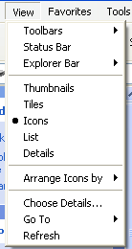
More Windows 7 Bars and Buttons
Some menu options are followed by ellipsis, or... Choosing a menu option followed by ellipses will open a dialog box, which feature helpful tools to help you perform tasks.
Choosing a menu option followed by an arrow head displays another set of menu options to choose from.
Menu options showing ellipsis
and arrow heads

Slide 153

More Windows 7 Bars and Buttons
Some Windows 7 programs (such as Microsoft Word have toolbars across the top of the window.
The toolbar buttons allow you to print, cut, paste, or do other tasks.
The options vary depending on the program.
_{Microsoft Word Toolbar}Department of Computer Science, KNUST-
Kumasi

Slide 154
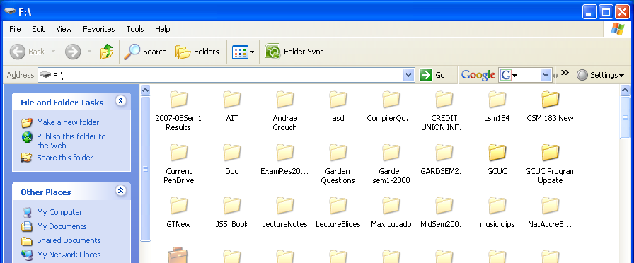
Scrolling
Window showing vertical Scroll Bar

Slide 155
Scrolling
Whenever for a particular window, one cannot see all the information within the window at the same time, Windows displays the scroll bar at the right side or the bottom of a window.
This is to make it possible for you view the hidden information by either moving the vertical scrollbar up or down, or by moving the horizontal scroll bar left or right depending on where the hidden information is.
It is especially convenient when viewing a long
document.
Department of Computer Science, KNUST-
Kumasi

Slide 156
Scrolling
To scroll,
Click the
Click the
Click the
Click the
Click the
OR
Click and drag the scroll bars to view your document.
arrow to scroll up. arrow to scroll down.
arrows to scroll up one page at a time. arrows to scroll down one page at a time. button to open a browse menu.

Slide 157
The Control Panel
The Control Panel provides a number of tools that helps you to
  customize the appearance and functionalities
  add and remove programs to/from your computer
  set up your network
  and also to create or remove user accounts.
  It also provides a means to ‘troubleshoot’ your
computer for problems and their solutions

Slide 158
To do any of the functions mentioned above, you will have to
Click Start.
Click Control Panel to open the control panel window.
OR
Type Control Panel in the Search box of the Start menu
OR
Double-click the Control panel icon on the desk top
In Windows 7 there are three different views of the control
panel namely
  the category view
  small icons view and
  large icons view
as shown on the next slide

Slide 159
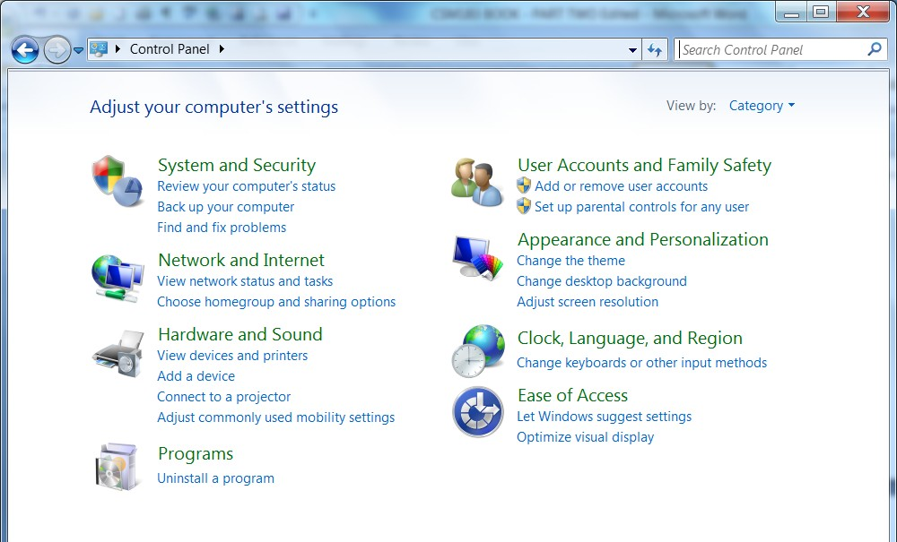
Category View of Control panel

Slide 160
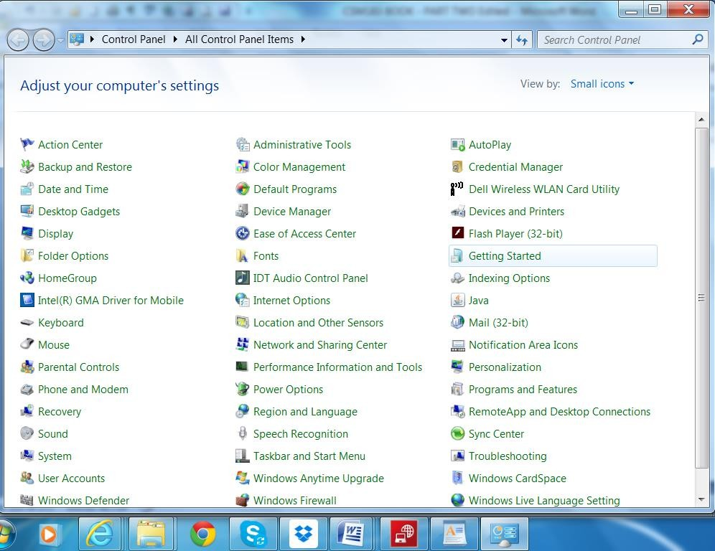
Small Icon View

Slide 161
If the view is Icons,
the window presents a List of Tasks and related Control Panel icons.
If the view is category then
windows present the categories to which the list of tasks belongs to.
Task and Control Panel icons perform basically the same functions.
If you look at the left side of the window, you will notice that the See Also and Troubleshooters dialog boxes provides several more related options.
To switch to any view simply look at the top right hand side of your current window and you will see View By: Click the arrow head, and select the option you want.

Slide 162
Setting Date and Time
Your Computer has an internal clock that keeps track of the date and
time and is normally displayed at the bottom left of the taskbar.
To change the time and date:
In the Category view , click Date, Time, Language, and Regional Options.
Under Pick a Task, click Change the date and time.
The Date and Time Properties dialog box opens.
Use the drop down box to set the month and year.
Click the correct date on the calendar.
Click and select the current time to make a change.
If necessary, click the Time Zone tab and use the drop down box to change the time zone.
Click OK to close the dialog box.

Slide 163
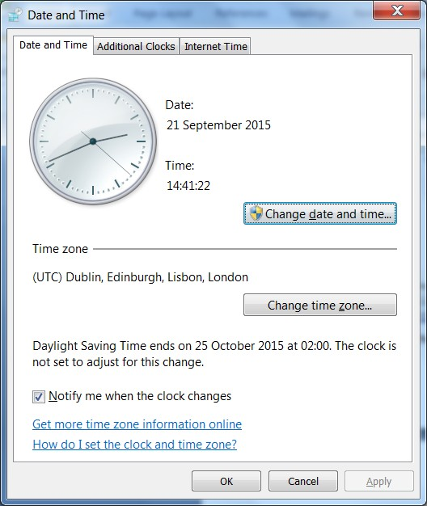
Alternatively
Right-click the time in the lower right on your desktop.
Choose Adjust Date
/Time.
roperties dialog bo
ps above.
The Date and Time P
opens.
Follow the last 4 ste
x

Slide 164
Changing the Wallpaper
Wallpaper is the background image that appears on your desktop. Windows 7 offers many wallpaper choices that you can select from if you don’t like your current wall paper.
To change the wallpaper,
Under Pick a Category in the Control Panel window, click
Appearance and Personalization.
Under Pick a Task, click Change the desktop background.
The Display Properties dialog box opens with the Desktop tab selected as shown on the next slide.

Slide 165
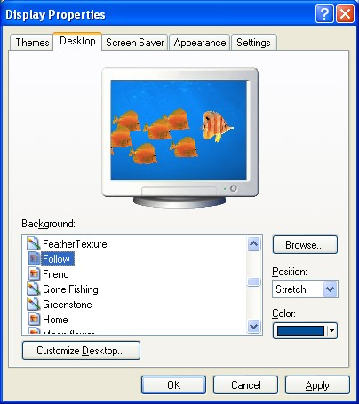
•The Display Properties dialog box opens with the Desktop tab selected as shown on the left.
In the Background box, click or use the arrow keys to view the choices.
Use the drop down boxes to alter wallpaper position or color.
Click OK to close the dialog box.
Alternatively,
Click Browse to choose a picture from the My Pictures folder
Click the Customize Desktop button to alter your desktop icons or display a web page on your desktop.

Slide 166
Changing the Screensaver
In the early days of computers, Screen savers were use to prevent images from being burned into the monitor.
Today, screen savers entertain us, by providing some privacy or preventing unauthorized user from using your computer if you should leave your computer unattended to for some time.
There is ‘on resume, password protected’, when enabled which will prompt whoever intends to use the computer for the password and access will be granted if only the password provided is correct.

Slide 167
To set your screen saver properties,
Under Pick a Category,
click Appearance and Themes.
Under Pick a Task, click Choose a screen saver.
The Display Properties dialog box opens with the Screen Saver tab selected as shown on the next slide.

Slide 168
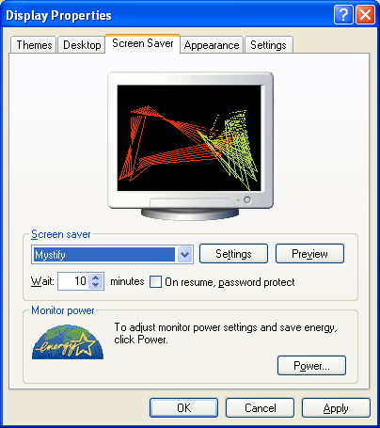
Click the arrow to open a
•
drop down box. Click or use the arrow keys to view the choices. Or, click Preview to view each option on your computer screen. Press any key on your keyboard to return to the dialog box.
Click Settings to customize the appearance or your chosen screen saver.
In the Wait box, determine how many minutes should pass before your screen saver turns on.
Display Properties dialog box with screen saver tab selected
Click OK to close the dialog
box when done.

Slide 169
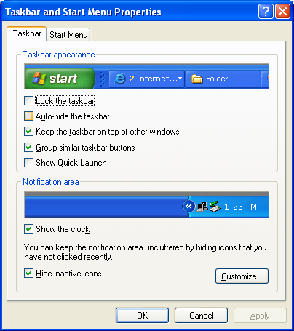
The taskbar has a default settings or appearance; however, you can customize the taskbar to appear the way you want. To do so simply,
Under Pick a Category, click Appearance and Themes.
Under Pick a Control Panel icon, click Taskbar and Start Menu.
The Taskbar and Start Menu Properties dialog box opens with the Taskbar tab displayed.
Use the checkboxes to customize its appearance and click OK.
Taskbar and Start menu Properties dialog box with taskbar tab selected

Slide 171
File Management
Files are collections of related information stored on a computer.
There are many different types of files, including
  operating system files,
  program files, and
  your personal files.
Different types of files store different types of information. Each file is given a filename and has a three0r four-letter file extension that identifies the file type. (The filename and filename extension are separated by a period.)
For example, a document created using Microsoft Word might have the file name, CSM183 Notes.doc. Some of the common file extensions are as follows:
doc: Word or WordPad document or docx: for Word 2007
txt: text file example document created with note or save as a plain text file by word or word pad.
eml: Email file
xls: Excel spreadsheet or xlsx (Excel 2007)
htm or html: HTML file (web page)
ppt: PowerPoint presentation or pptx (power point 2007)
mbd: Access database

Slide 172
Creating, Renaming, and Deleting Files
Normally you must give meaningful names to your files so that by
just the name you can easily tell what the file is all about.
With Windows 7, you can create a file using different programs such as WordPad or Notepad. To create a file using Notepad:
•
•
•
•
•
•
•
Click Start.
Choose All Programs - Accessories - Notepad. Notepad opens.
Type, "This is my new document."
Choose File Save from the menu bar (Ctrl + S).
The Save As dialog box appears as on the next slide Save your file to the desktop.

Slide 173
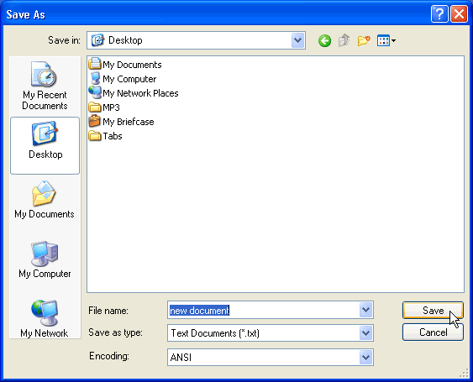
Name your document “new document.”
In the Save as type drop down box, be sure your document is saved as a text document.
Click Save. Your file is now saved to the desktop.
The Save As dialog box

Slide 174
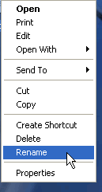
To rename a file,
Once you have created a file, you can rename it if you think that the current file name does not help you to easily identify what the file is all about.
Locate your file either on the desktop or in
Right-click the file icon.
Choose Rename.
The filename is highlighted in blue, ready t retyped.
Type a new name and press Enter.
The file is renamed.
a folder
o be

Slide 175
OR
Locate the file either on the desktop or in a folder
Click slowly on the file name twice (not the file icon)
The current file name will be selected. It will be in a white rectangle and the filename in a blue background.
Use the cursor keys to move around to effect the change or simply type the new name.
Click anywhere outside the file name rectangle box when done.

Slide 176
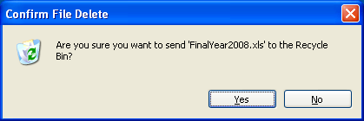
To delete a file:
•
•
•
Locate your file
Right-click the file icon. Choose Delete.
A Confirm File Delete dialog box appears asking you if you
are sure you want to send the file to the Recycle Bin.
•
•
Choose Yes.
The file is moved to the Recycle Bin
OR
•
Locate your file and click the file icon or the file name once
Press the delete key on your keyboard. You will also obtain the confirm file delete box as above

Slide 177
Folders
A folder is just like a file cabinet. When you create many files its difficult at times to find a file as you have to scan through all the files. To keep your files organized, create need to create folders.
Windows 7 uses various folders to store and manage files. Each folder is then used to keep files that are related so that you can find the file within a short time as there may not be too many files in that folder.

Slide 178
To open and view the contents of a file:
Locate the file whose content you need to view. Double- click on the name of the file to view
The application program that was used to create the file will first run and then the document/file to be viewed is loaded into memory for you to view.
OR Right-click on the file name after you have located it and click on Open
OR Locate the file, click the name of the file once and then hit the enter key to open it.

Slide 179
Alternatively, you may
run the application program used to create the file
go to the file menu
select open
locate the file
click the file name
and then select OK.

Slide 180
Creating, Renaming, and Deleting Folders At some point, you may want to create a folder within a folder or create a folder on the desktop.
To create a new folder for example:
Locate where the folder is to be created.
Choose File New Folder.
A new folder icon appears with its default name ‘New Folder’ highlighted.
Type a new more meaningful name and click
•
Enter.

Slide 181
Alternatively,
Locate where the folder is to be created.
On a blank area right click the mouse
Select New Folder
A new folder icon appears with its default name
‘New Folder’
.

Slide 182
To rename a folder:
Locate your folder.
Right-click the folder icon.
Choose Rename.
The folder name is highlighted in blue, ready to be retyped.
Type a new name and press Enter.
OR
Locate the folder
Click at the folder once
Click at the name of the folder, this will select the current folder
name to enable you type in the new name
Type a new meaningful name

Slide 183
To delete a folder:
Locate your folder.
Right-click the folder icon.
Choose Delete.
A Confirm Folder Delete dialog box appears asking you if you are sure you want to send the file to the Recycle Bin.
Choose Yes.
The folder is moved to the Recycle Bin.
•
OR
Locate the folder
Click the folder icon.
Press Delete (Del) on the keyboard to delete the folder. Note that when a folder is deleted its content; files and sub folders are also deleted

Slide 184
Drives
A drive, or disk drive, is a hardware device on which you can store files and folders. Disk drives are assigned a letter.
Your hard drive is known as the (C:) drive.
Your floppy disk drive is known as the (A:) drive or the letters A: and B if there are two.
If your computer has a CD ROM drive, it is usually called (D:)
If you insert a pen drive into your USB port, it will normally be given a drive letter higher than your CD- ROM drive letter.

Slide 185
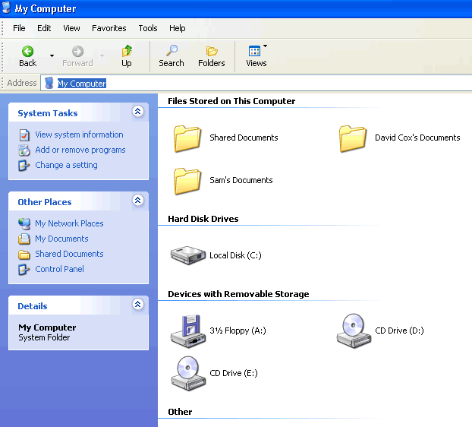
,
Exploring My Computer
My Computer or file explorer is another tool you can use to manage files and folders.
With thes tool, you can create, rename and move folders and copy, print, move, delete and rename files. It also allows you to gain access to other system tools.
Figure 9.3 The My Computer windowy Computer:
Double-click the My Computer icon on the desktop or click on the file explorer button on the task bar
My Computer opens.
Alternatively,
To open M
•
•
Right-click the My Computer icon (on the deskto Choose Open Or
p).
Open the Start menu and choose My Computer.

Slide 186
Copying Files and Folders
To copy a file or folder,
Locate the file or folder you want to copy in the required folder or its subfolders.
Click the file or folder you want to copy. The file or
folder darkens when you select it.
Under File and Folder Tasks, click Copy this file or Copy this folder.
In the Copy Items dialog box, select the place where you want to copy the file or folder from.
Click the Copy button.
•
•

Slide 187
OR
Choose Edit Copy. (Ctrl + C) Alternatively,
Right-click the file or folder and choose Copy.
Locate the file or folder you want to copy and choose Edit Paste. (Ctrl + V)
OR
Right-click the file or folder and choose Paste.

Slide 188
Alternatively, to copy a file from one folder (source) to another (destination) you can open and juxtapose the two folders.
You can then click at the file to be moved from the source folder, hold down the left button of the mouse and drag the file to the destination folder.
Then release the mouse button when done.

Slide 189
Moving Files and Folders
The difference between copying a file and moving a file is that while the copy makes a duplicate copy of the original file to the new location, the move on the other hand remove the file from its present location and send it to its new location.
To move files and folders:
Locate the file or folder you want to move in the required folder or its subfolders.
•
Click the file or folder you want to move. The file or folder when you select it.
darkens
Under File and Folder Tasks, click Move this file or Move this folder.
•
In the Move Items dialog box, select the place where you move the file or folder.
Click the Move button.
want to
•

Slide 190
OR
Choose Edit Cut. (Ctrl + X)
Right-click the file or folder and choose Cut. THEN
Locate the file or folder you want to copy and choose Edit Paste. (Ctrl + V)
Right-click the file or folder and choose Paste.
OR
•

Slide 191
Selecting More Than One File or Folder
More often than not you may need to copy or move multiple
files and folders at the same time. To do so,
Hold down
the Ctrl key (if the files and the folders are scattered)
or shift key (if the files and folders follow one another, that is, are consecutive group of files) and click to select the files or folders you want to move or copy.
For the shift key, just click on the first file, hold down the Shift key and then click the last file and all those between them will be selected as well.
The files or folders darken as they are selected.
Copy or move the file or folder using one of the methods explained on the previous pages.

Slide 192
You can display them as thumbnails, tiles, large icons, small icons, as a list, or as a list (Details) with details including size, type and date last modified.
To choose the view for your files or folders:
Choosing View
Open the required folder
Click the Views button.
A drop down menu appears. Choose the required view.
A large black dot appears next to your current choice.
OR
Open the View menu and choose your view.

Slide 193
A shortcut offers the best way of doing a task more quickly such as starting a program or accessing a document. The shortcut icon has a small arrow in the left corner to help you distinguish it from the actual icon that represents programs and files.
Deleting a shortcut does not affect the original item the shortcut points to.
Creating a Shortcut
There are a number of ways by which one can create shortcuts for files
and programs. Below are some of the commonly used methods.
Creating a shortcut to the desktop using Windows Explorer or My Computer:
•
•
•
Open Windows Explorer or My Computer.
Double-click a drive or folder.
Click the file, program, or folder for which you want to make a shortcut. The item darkens when you select it.
Choose File - Create Shortcut
•

Slide 194
Resize the window to see the desktop.
Hover the mouse pointer over the shortcut icon and hold down the left mouse button and drag the shortcut onto desktop (in the
left pane).
Release the left mouse button and a shortcut is moved to the desktop.
Alternatively, press Ctrl + Shift while dragging the file to the desktop to create a shortcut.

Slide 195
The quickest way of creating a shortcut requires a right-click. To add
a shortcut by right-clicking:
Right-clicking to Add a Shortcut
•
•
•
Open Windows Explorer or My Computer. Double-click a drive or folder.
Right-click the file, program, or folder for which you want make a shortcut.
A pop-up menu appears. Select Create Shortcut. Resize the window to see the desktop.
Move the mouse pointer over the shortcut icon and hold the left mouse button and drag the shortcut onto desktop left pane).
Release the left mouse button and a shortcut is moved to desktop.
to
•
•
•
down
(in the
•
the

Slide 196
The Recycle Bin
When you delete any file, the file is kept in the recycle bin.
A file in the recycle bin can be retrieved if the need be.
The Recycle Bin is the desktop icon that resembles a
wastebasket.
It is possible to open the Recycle Bin folder anytime and see what's inside by double-clicking the Recycle Bin icon located on the desktop or using Windows Explorer.
You can delete an item by moving it to the Recycle Bin. The items can be moved from anywhere.
To move an item to the Recycle Bin from the Desktop, Windows
Explorer, or My Computer, the steps required are as follows

Slide 197
Click and drag the file or folder to the Recycle Bin.
OR
Right-click the file or folder you want to delete. .
When the pop-up menu appears, choose Delete.
A dialog box appears asking, "Are sure you want to send the file or folder to the Recycle Bin?"
Click Yes.
OR
Click the file or folder you want to delete.
The file or folder darkens.
Choose Delete this file (or Delete this folder) from the File and Folder Tasks list.

Slide 198
Click the file or folder you want to delete.
The file or folder darkens.
Choose Delete this file (or Delete this folder) from the File and Folder Tasks list.
•
Restoring Files From the Recycle Bin
Though items in the Recycle Bin are deleted items you can still retrieve them at a later date. You can restore either a single file, group of files or all files. Using the Restore all items link (located in the Recycle Bin Tasks list) will move all files and folders in the Recycle bin back to its original location on your computer.
To restore all items in the Recycle Bin,
Click the Restore all items link in the Recycle Bin Tasks list that appears on the left side of the screen
The items are restored to their original locations.

Slide 199
To empty the Recycle Bin,
Click the Empty the Recycle Bin link in the Recycle Bin Tasks list.
It is also possible to delete some of the items in the recycle bin. Note that this will delete the items permanently. To do so, just select the item(s) to be deleted.
Right click the mouse button and then select Delete.

Slide 200
At times, it is possible for one not to remember where an item on his/her computer can be located. This is normally the case when you have too many folders and folders within folders. Windows 7 has a search facility that makes it possible to look for files and folders whenever you are in trouble looking for a file by using the Search Companion.
Opening the Search Companion
To open the Search Companion:
Click the start button to obtain the Start menu and choose Search. OR
Open My Documents and click the Search button. OR
Open My Computer and click the Search button.
Any of the three methods opens the search companion. The Search Companion opens in the left pane and presents the following list of options:

Slide 201
To search using the Search Companion:
Enter as much information as you can remember into the Search Companion. For example by providing all or part of the file name, a word or phrase in the file, which drive to look in, etc
You can also click the drop down arrows to add more criteria if necessary.
Use the Back button if you have to go back and change your option.
•
•
Click Search.
Once you click Search, the Search Companion tells you
it's
searching.
Your search results display in the white space.
•

Slide 202
The Search Companion tells you when the search is complete and prompts you with more Search options.
If your search is complete, click Yes, finished searching.
If the file is found then simply double-click the to open it.
•
file
No matter the number of files on your computer, finding a file can take seconds, minutes or much, much longer depending on the type of search and where you are looking. If the search fails to locate the file on your first try, type in a different name and/or location.

